Slide 1

ONE TAP UPDATER
Say No to Manual Entry!
Manish Kumar
Varishu Pant
Rahul Aggarwal
Kedarkumar Golla
Ankit Sekseria

Slide 2




PROBLEM
Banks and Colleges handle hand-filled forms that need to be entered manually incurring waste of resources.
Notes:
We’ve all witnessed the growth of technology in the past few decades and how its effect has penetrated even the oldest of professions :Banking. We have online payments, fund transfer, even opening new accounts have never been easier. But with all that good comes the bad , that being cybercrimes.. Due to which banks still prefer hand filled forms for a lot of applications. But not just banks, there are various organizations that have paperwork that’s needed to be entered manually in the system. That takes time and moreover incurs costs which include hiring employees for the job.

Slide 3




OBJECTIVE
To create an application using which scanned handwritten forms can be converted to excel sheets.
Notes:
We took an initiative to solve this annoyance by automating the form updates. A way to input the form, and generate an excel sheet that carries all the information.

Slide 4

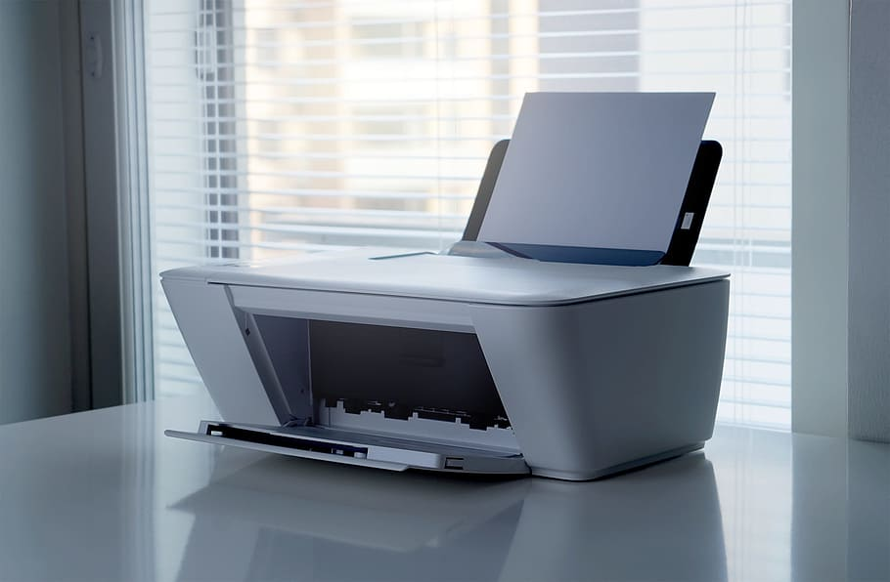

SKETCH OF THE PROJECT
Stored
as image
Scanning
Hand Filled Form
App Output
Process image in-app
Excel with Info Generated
Notes:
The hand filled form needs to be scanned and converted into an image. That image is stored in a PC. The user just needs to open up the application and select the scanned image. The application will then process the image give out an excel sheet containing the information that was filled in the form

Slide 5
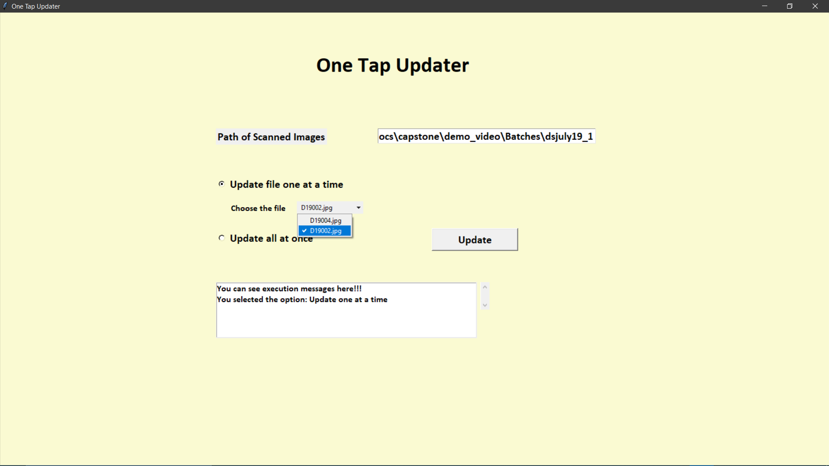

GLIMPSE OF FINAL PRODUCT

Slide 6



PROCESS FLOW
Data
Modelling
Conversion
Notes:
1 data collection(we can expect question)
2. Box detection(we can expect a question here how you detect a box ) in the your form box is given if the box is not given then how u detect the letters?
3.questions in our model selection(which model is working fine and why?
Add boxes pics … means boxes detected from images
We haven’t use it any where.

Slide 7
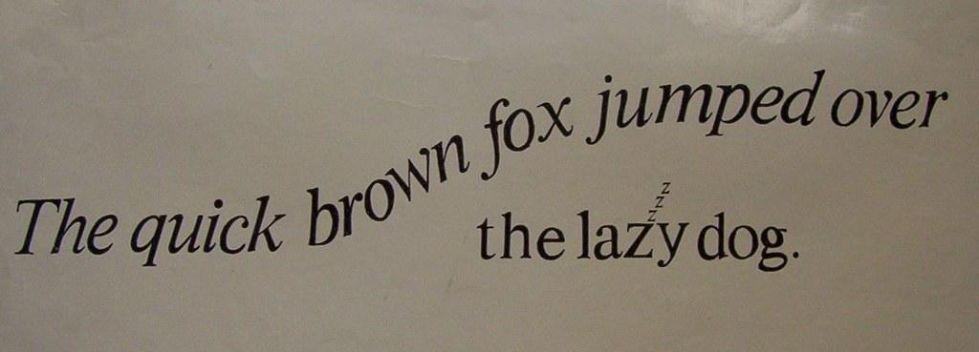
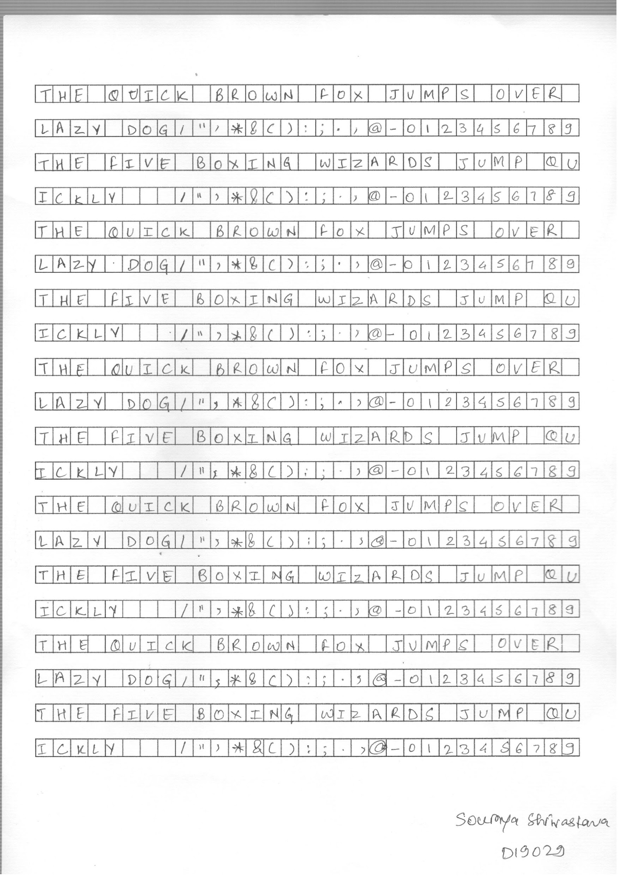
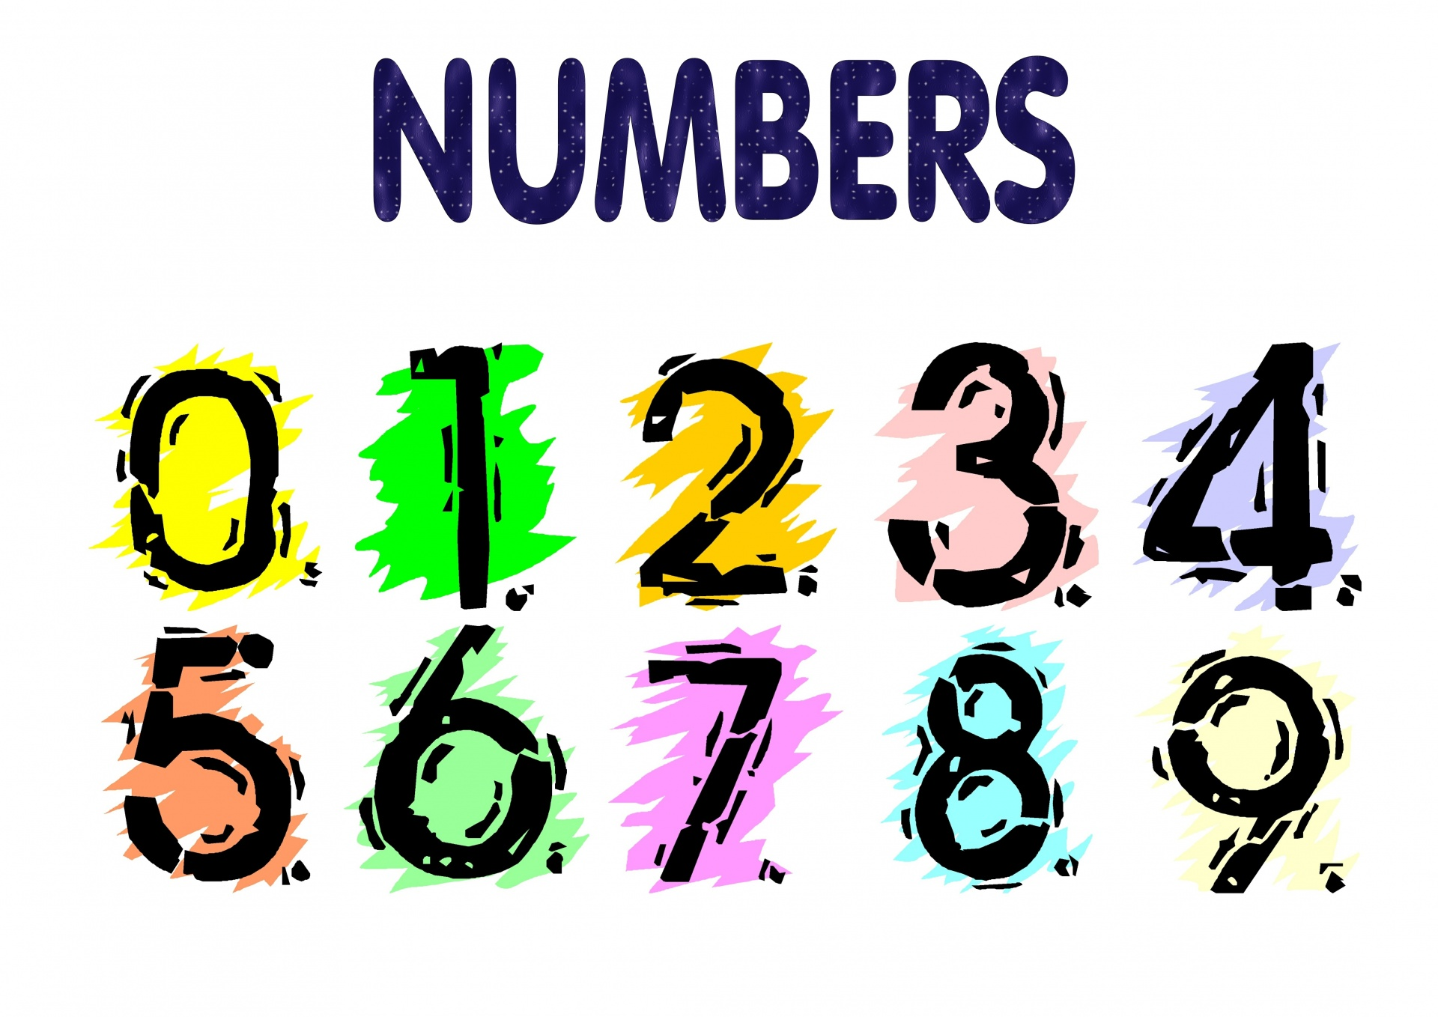
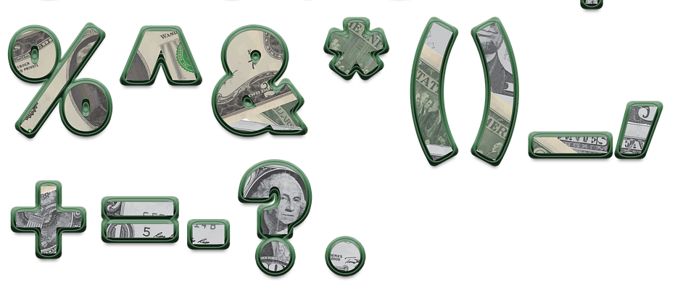
DATA
2 Phrases that contain all 26 alphabets of the English language
Notes:
We created a standard form template and took the help of both the student batches to collect data. The form contained 2 hand picked phrases that contained all 26 alphabets of the English language. Also digits from 0 to 9 and 16 special characters including white space, braces , and punctuation marks, etc.

Slide 8
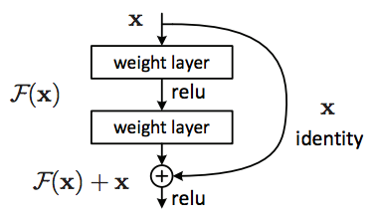
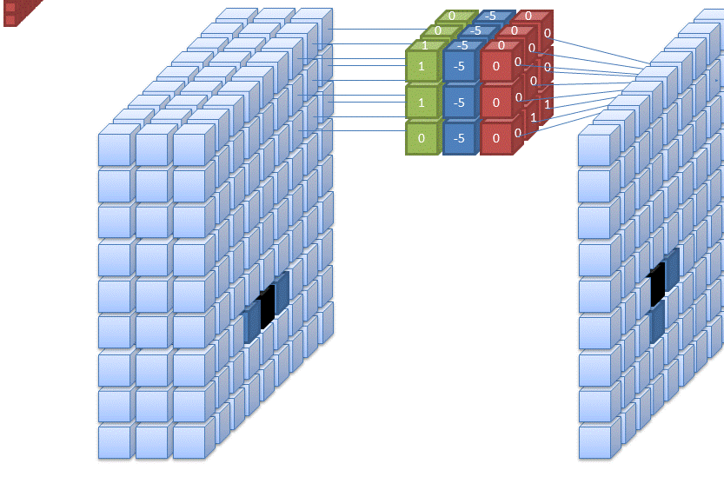


MODELLING
47 Total Classes
• Train[Batch’ 20 + NIST]- 21,540 + 98,000 = 1,19,540
• Valid [Batch’19 – 13,047]
Started out with creating our own convolutional neural network.
Due to low accuracy, we turned to prebuilt architectures like Inception and LeNet.
Chose ResNet through Experimentation
Original Class set – 65*65 [Resized]
NIST – 128*128 [Cropped]
Reshaped to 78*78

Slide 9
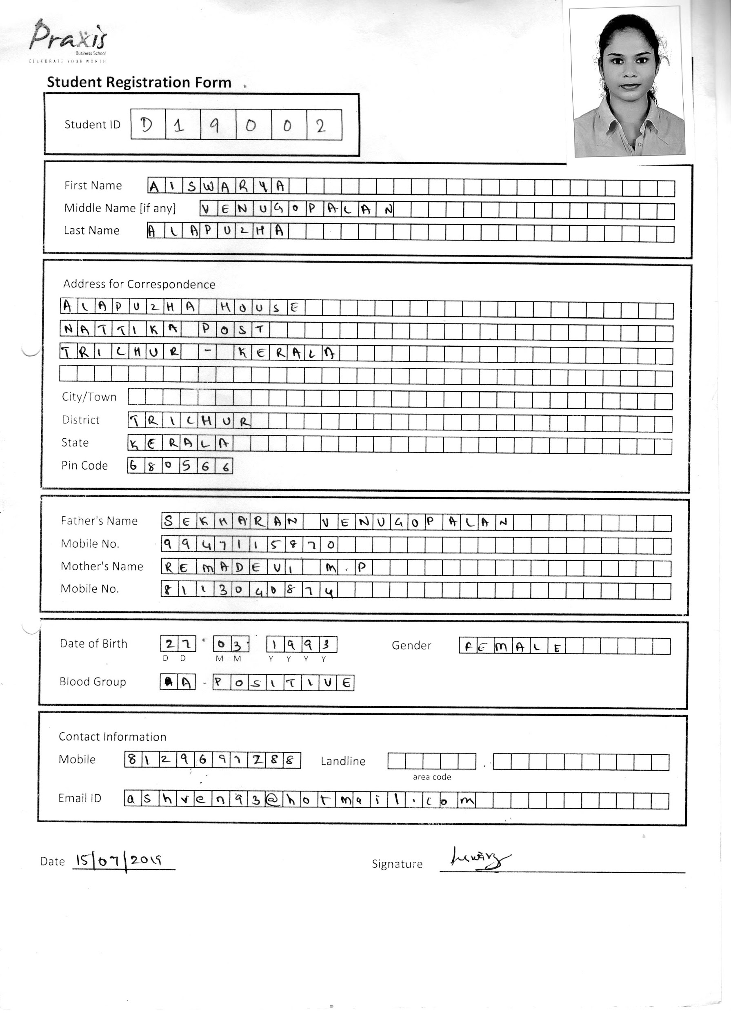
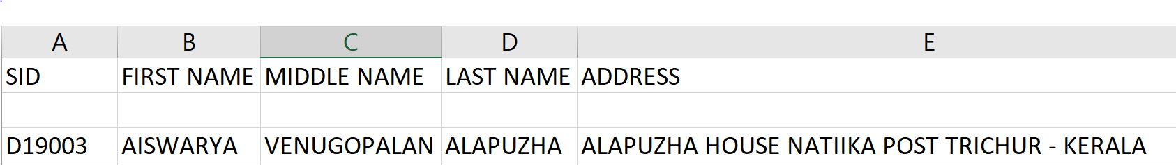
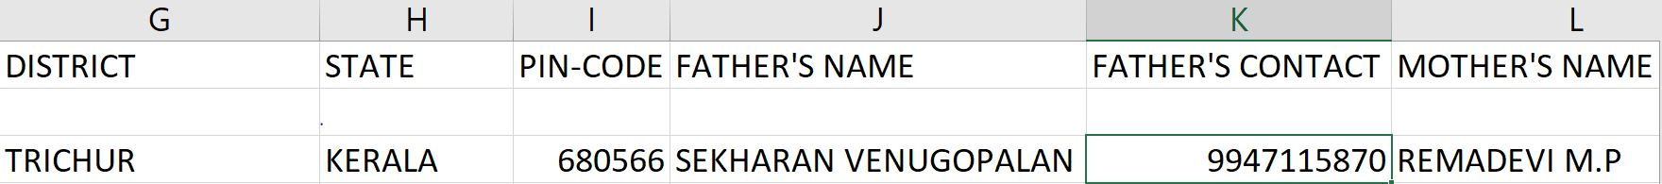
CONVERSION
Each student registration form gets converted into a row of the Excel sheet.
Notes:
We used our trained model to predict characters in Praxis student registration forms . Each form gets processed and converted into a single row of information about the student.

Slide 10
STAGES OF THE PROJECT
Getting a bit technical

Slide 11

Collecting Data
Notes:
We have collected data on standard template and take the help of hand from january and our classmates to fill the template and

Slide 12
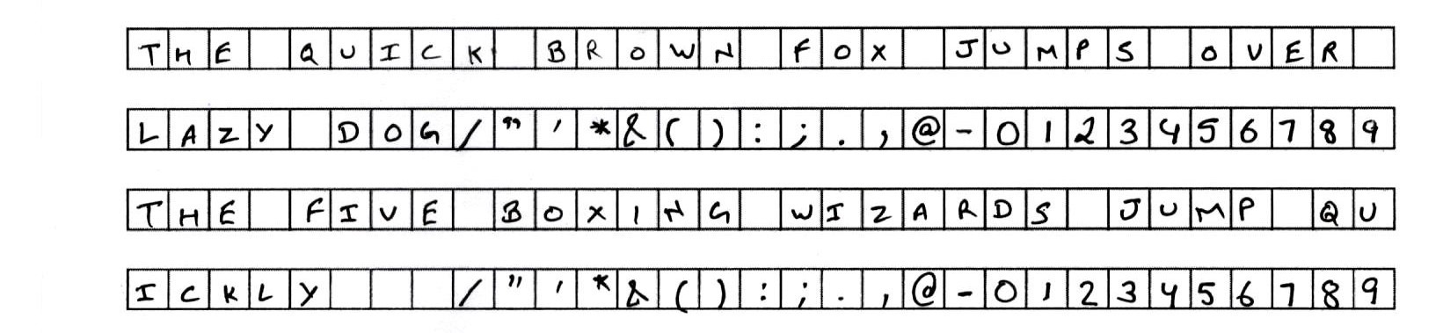
Collecting Data
4 lines repeated 5 times per form to achieve standardization
Scanned forms with 300dpi for better contour detection
Collected data in 3 groups. Once from 2019 batch and twice from 2020 batch. Done to get variations in handwriting.
A margin was given during sorting to handle form tilt up to 5 degrees.
Notes:
In the data collection we have followed “the quick …………………………. Dog” which has 26 latters(so we can take name of student, name of student’s parent and there address. And we have also taken 1 to 9 numbers for there mobile number and adress, and we have also added special character so we can take the student’s email id and blood group. We have collected data 2 times from january batch

Slide 13

Collecting Data
Data Preprocessing
Notes:
We have collected data on standard template and take the help of hand from january and our classmates to fill the template and

Slide 14
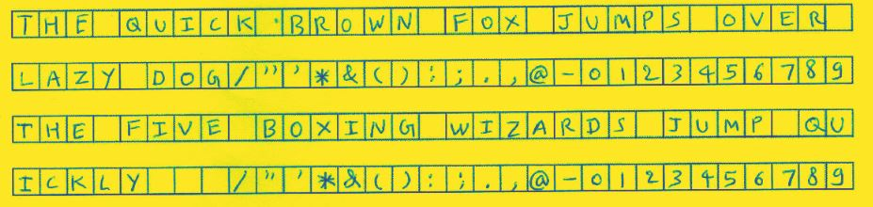
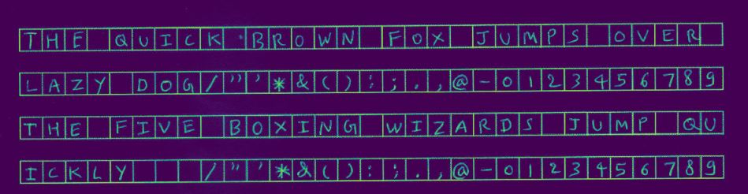
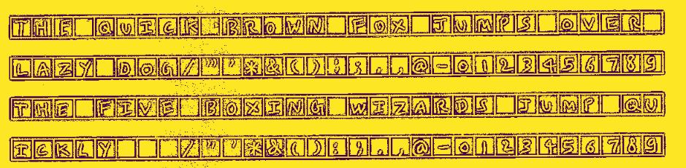
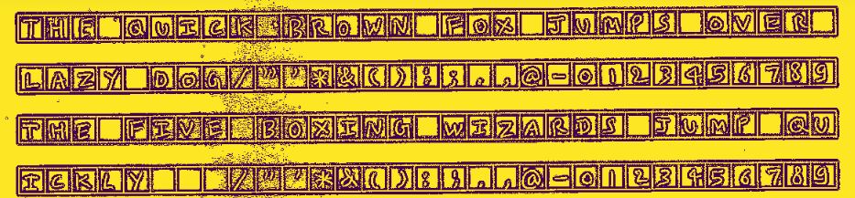
PREPROCESSING
Binarization
Image contains 2 differently sized contours:
Rectangles and boxes
Thresholding
Dilation
Notes:
Image was read in grayscale mode and then a series of noise removal tasks were performed. First was binarization , to localize the text against the background. The binarized image was thresholded adaptively using a Gaussian weighted sum of the neighbourhood values. Next we dilate the image to make the characters more prominent.

Slide 15



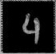


Character Extraction
Collecting Data
Data Preprocessing
Notes:
We have collected data on standard template and take the help of hand from january and our classmates to fill the template and

Slide 16
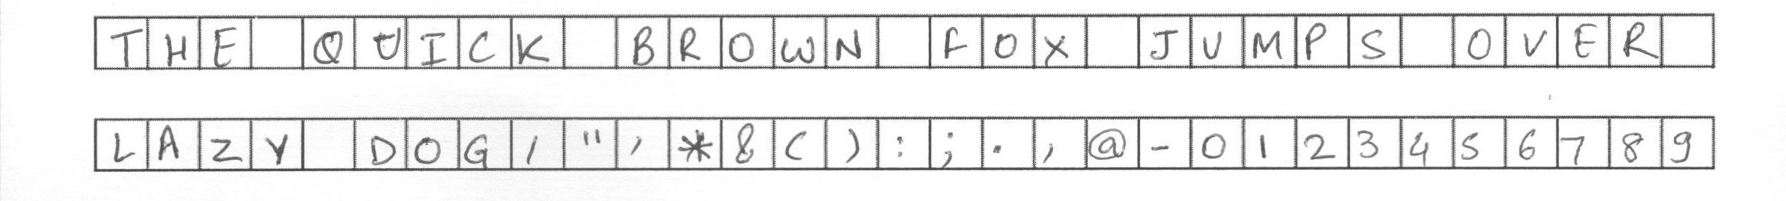



CHARACTER EXTRACTION
Detected contours and extracted first the outer boxes(or rectangles) and then the inner boxes(or squares) that contain the characters.
After repeating noise removal steps for contours along with smoothening techniques, we get:
Characters were sorted according to pixel coordinates to get the correct order for ease of storage and labelling.

Slide 17
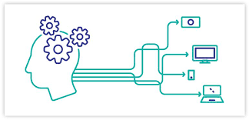
Character Extraction
Collecting Data
Data Preprocessing
Training
Notes:
We have collected data on standard template and take the help of hand from january and our classmates to fill the template and

Slide 18
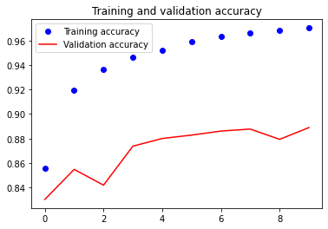
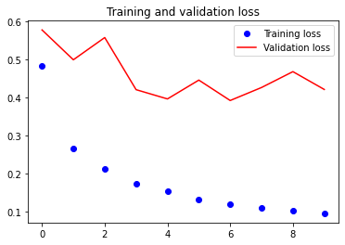
Training
Trained ResNet from scratch:
Epochs=10
Batch Size=32
Optimizer=Adam(Learning rate= 0.001
Loss Metric=Categorical CrossEntropy
Time Per Epoch=437 seconds
Validation Accuracy: 88.5%
Data Augmentation Techniques used:
Shear
Zoom
Rotation [To handle form tilt]

Slide 19

Character Extraction
Collecting Data
Data Preprocessing
Training
Deploying Prototype
Notes:
We have collected data on standard template and take the help of hand from january and our classmates to fill the template and

Slide 20

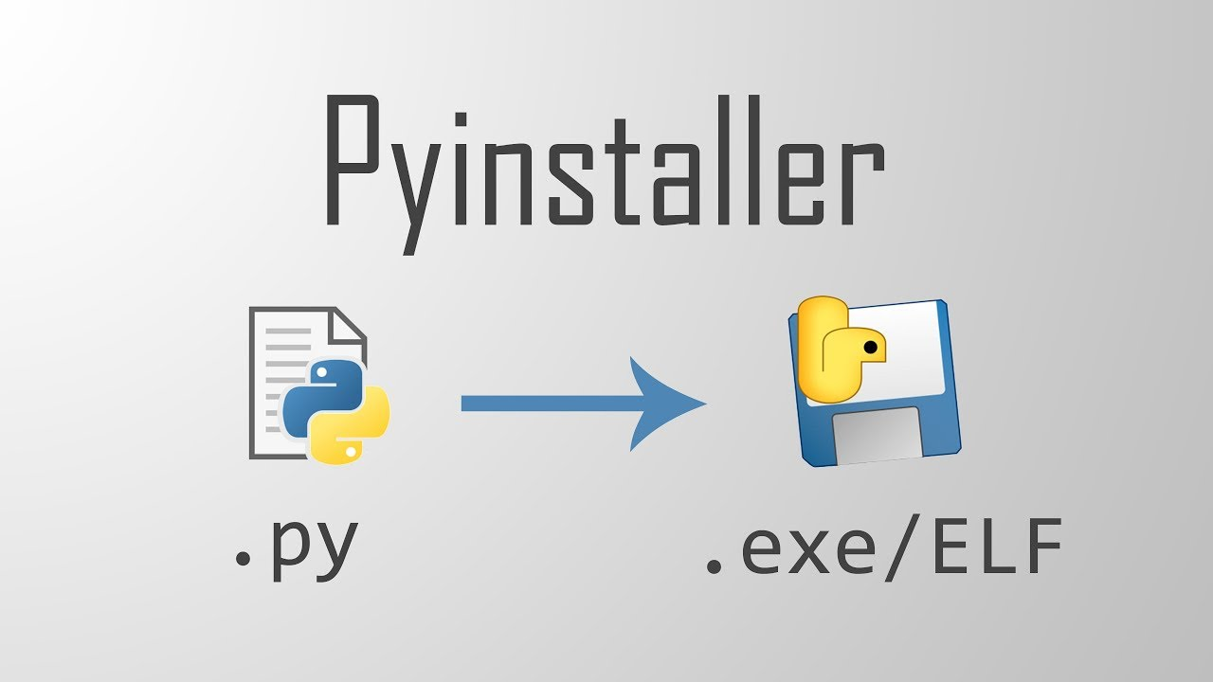
Deploying Prototype
Used TkInter to create the GUI and Pyinstaller to convert it into an executable
Notes:
After building the model we needed to create a prototype. We used tkinter for creating the gui and converted our python scripts into a windows executable file for desktop using pyinstaller.We need to save the .exe file in the desired folder and run it, which will automatically open the user interface

Slide 21
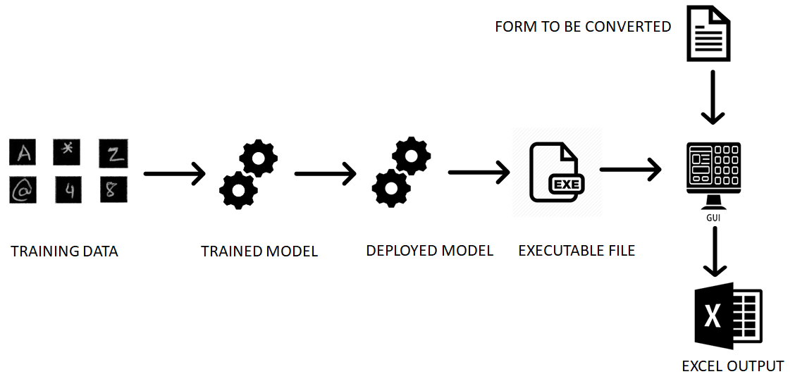
Deployment Process
Notes:
After extracting characters we trained the model and used this trained model for predicting.after ww give input to the app it will update the information in the image to the excel.

Slide 22
Character Extraction
Collecting Data
Data Preprocessing
Training
Deploying Prototype
Notes:
We have collected data on standard template and take the help of hand from january and our classmates to fill the template and

Slide 23
FUTURE DEPLOYMENT
Plan Of Action to Deploy the App
Notes:
How can we deploy the file in future?

Slide 24
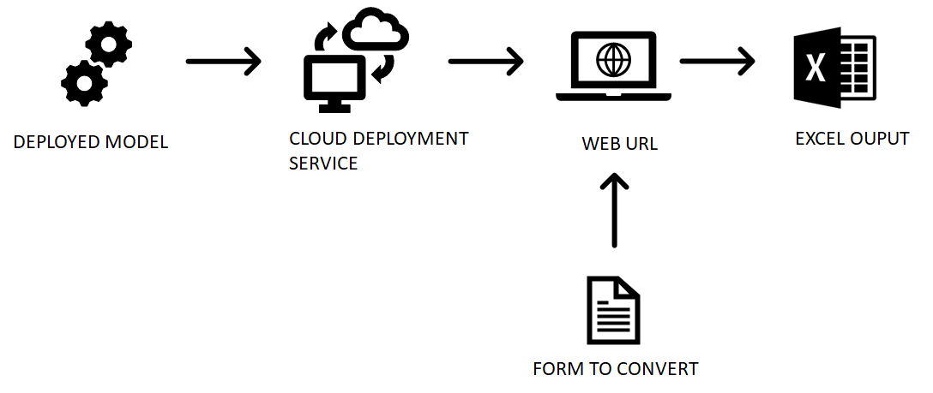
CLOUD DEPLOYMENT
Notes:
We can use cloud deployment services and create web url using frameworks like flask.Here we can update the files in excel and then ask the user to download it.

Slide 25
JOURNEY AND EXPERIMENTATION
Started from the bottom

Slide 26
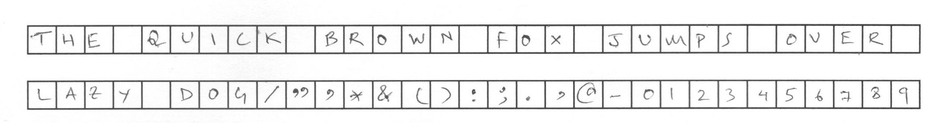
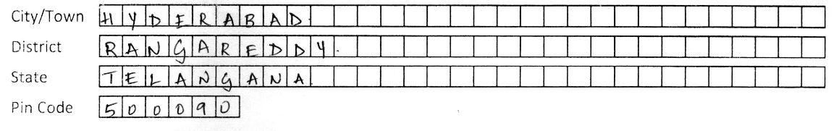
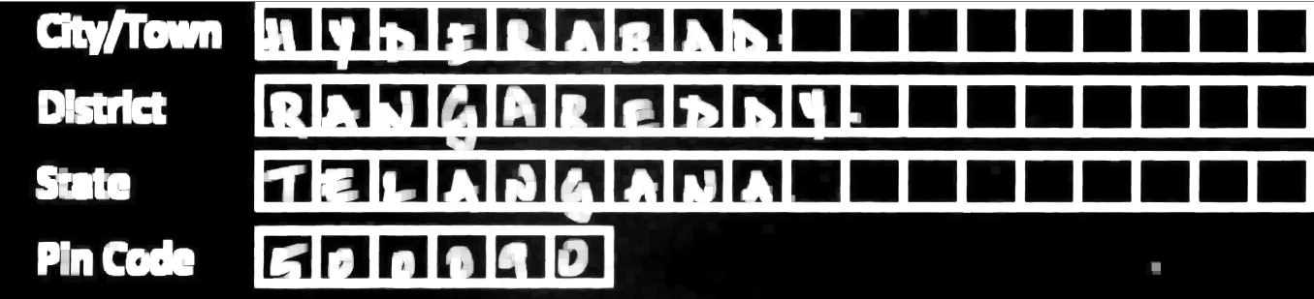
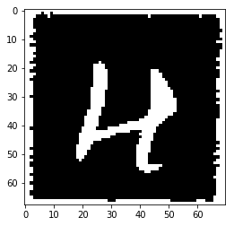

Journey
Contours Detection - Used different technique - CannyEdge, BoundaryRect.
Boundary Correction - Used Noise Removal Techniques (dilation,Gaussian, adaptive Thresholding) to overcome missing outline issue.
Train and Inference mismatch - Cropped smartly to remove outer boundary from train data.
Notes:
Detecting contours - Canny Edge (Faced Issue of differentiating inner and outer rectangles.
CV2 - getcontours and bounding rect ( tree structure,simple structure option) but faced no proper result due to letters like D,B also contributing in contours. Also there was some boxes whose outer outline not visible from some places.
Noise removal techniques gaussian blur , dilation also not able to detect 100% boxes.
Used concatenate of different noise removal outputs and tuned it using different combination of hyperparameters, so unique set can give all required contours.
This was one of most challenging and breakthrough for our journey.
After data collection, in training unable to get validation accuracy. After analysing realised while training model data had outer boundary but for validation outer boundary was missing. So, later rectified and used crop and threshold. (image example)
Started with model validation accuracy of 34% on 51 classes and was able to get 89% accuracy in final model.
Even with 89% accuracy, the output not as expected while saving in excel sheet.
So,To further improve the prediction used custom rule as per form format.
To let layman person also able to use our product made a exe file for GUI.

Slide 27
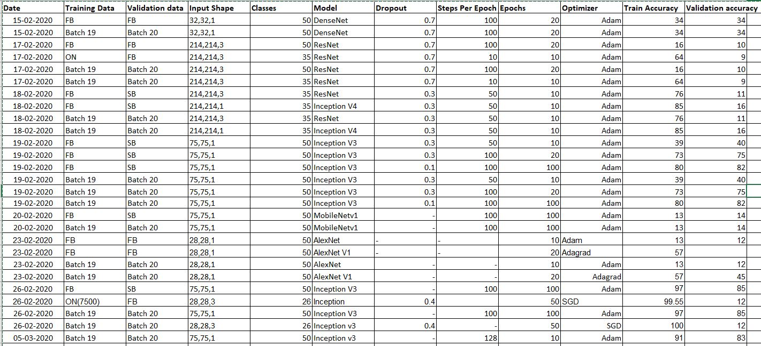
Experiments:

Slide 28
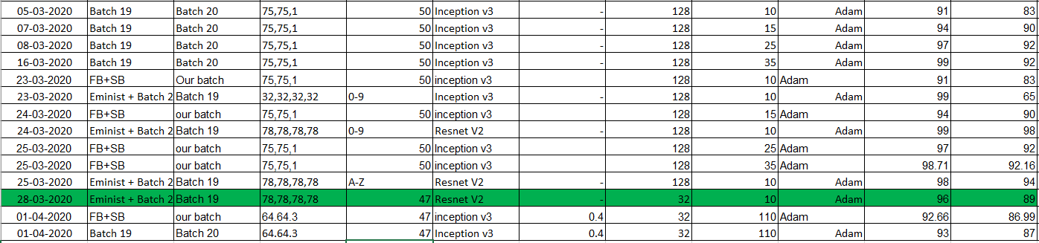
Time taken for conversion was huge and not scalable for large amounts of files during batch update. To overcome this, we took 2 steps:
1. Removed 4 classes that were not getting encountered even once, namely "(quotation marks), '(apostrophe), ;(semi-colon) and *(asterisk).
2. Instead of using multiple models, we used only one, trained on all 47 classes.
Notes:
Custom rules for further improvement of output.

Slide 29
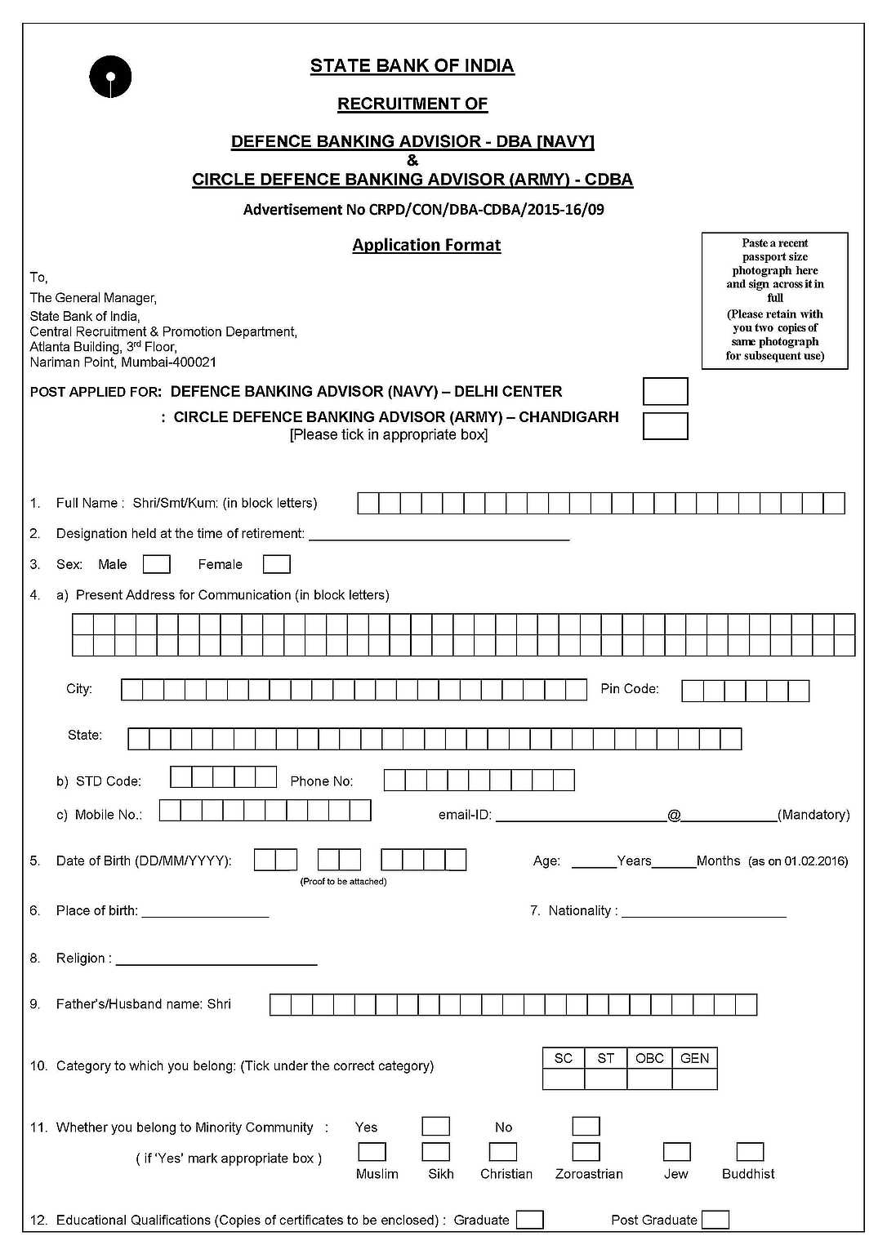
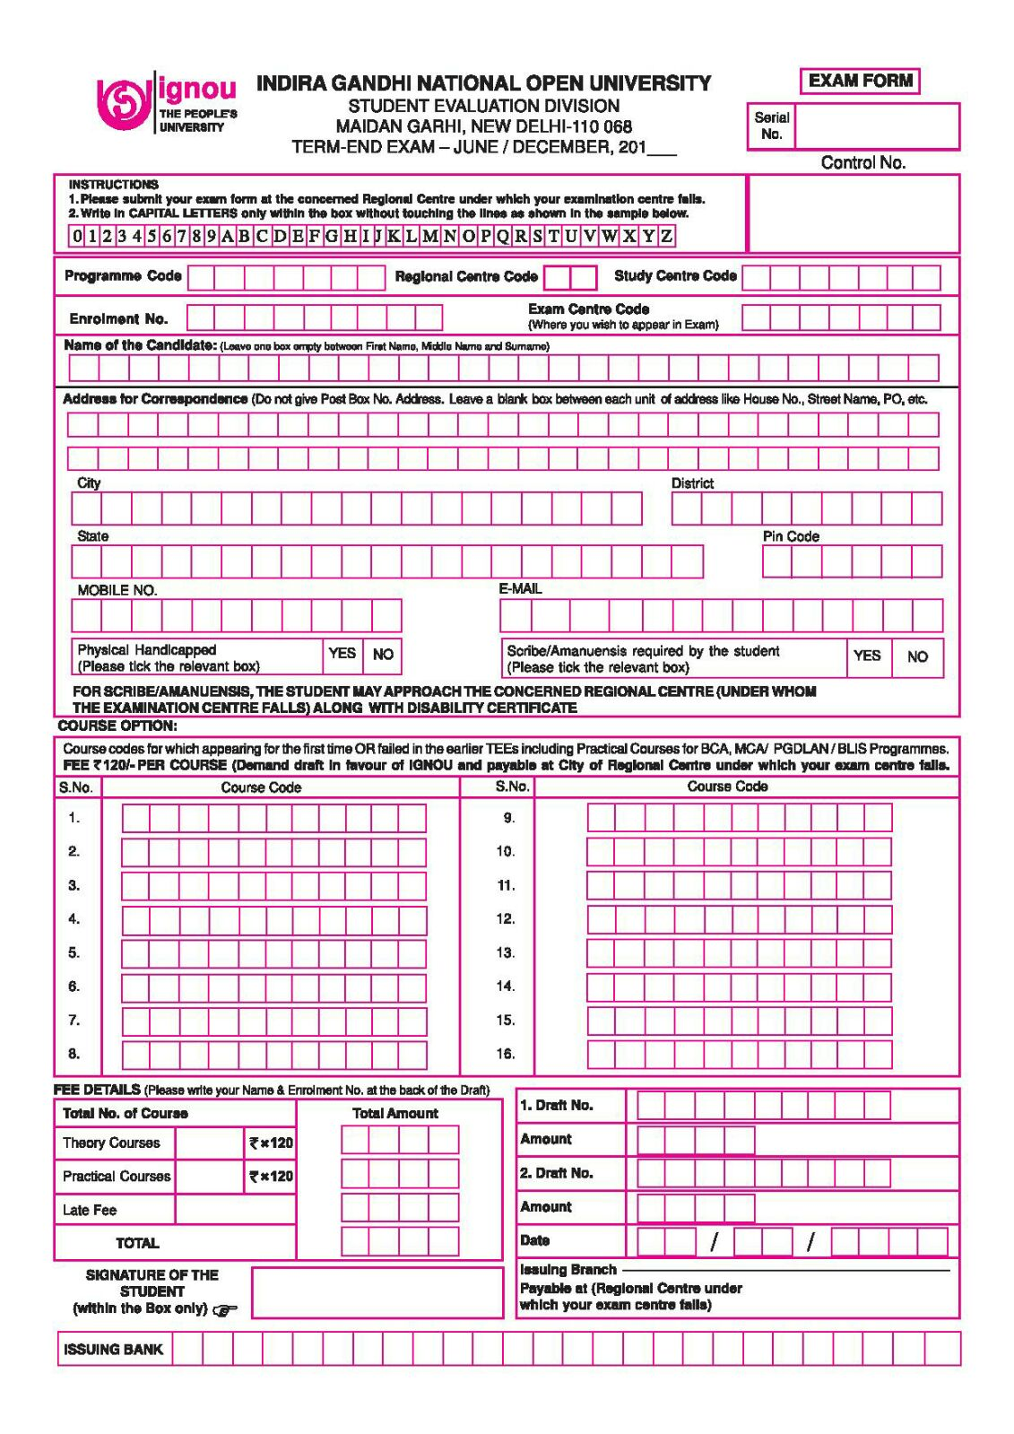
SCOPE
The work done in this project can be done for different organisations who use handwritten application forms.
Some Examples are :
Recruitment form of State Bank of India.(Top left)
IGNOU university application form.(Bottom left)
There are a lot of organisation who use handwritten forms and can benefit from One Tap Updater.
Notes:
Ankit, write speaker notes for the sections u worked on coz ull be speaking about them tomorrow

Slide 30
ACKNOWLEDGEMENTS
Giving credit where it’s due!

Slide 31
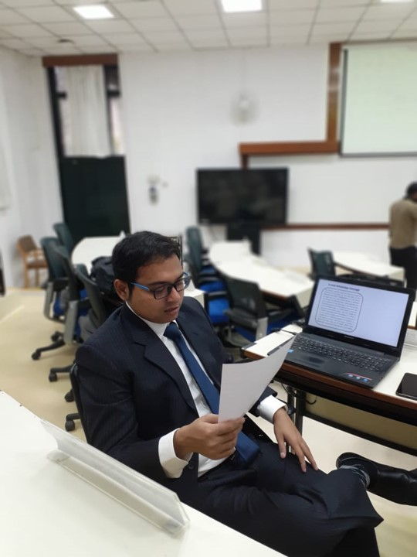
Huge Thanks To
Our Mentor
Gourab Nath
Assistant Professor, Data Science
Praxis Business school, Banglore
Thanks for all the help and for guiding us through this amazing journey!

Slide 32
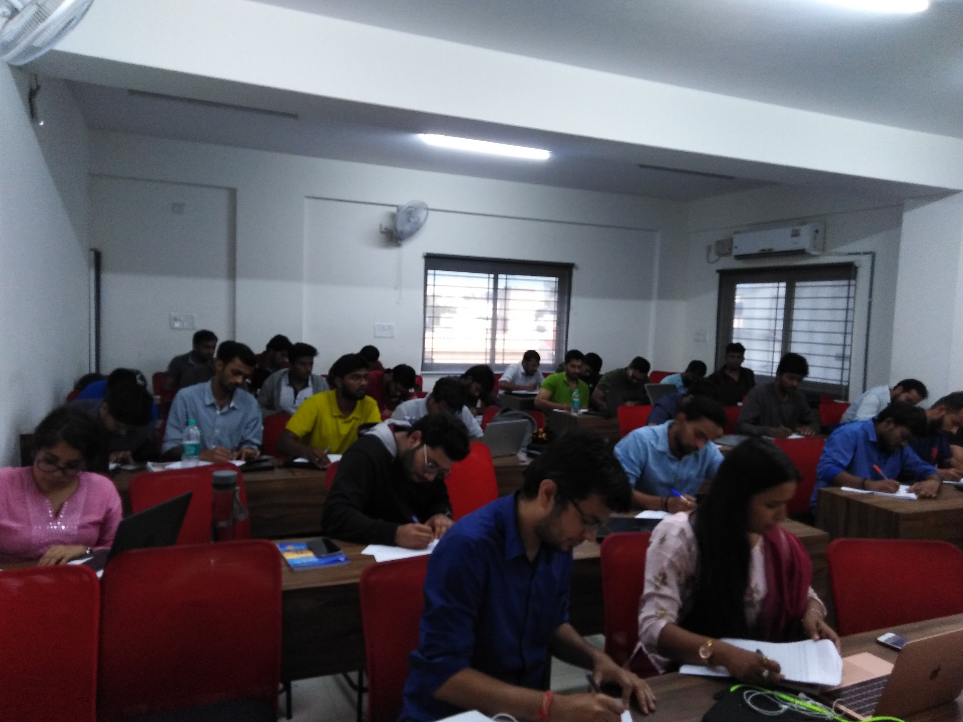

Thanks to the January batch and our classmates for helping us in data collection!
Thanks to Praxis for giving us this opportunity!
Notes:
Thanks to Praxis for giving us this opportunity to apply what we learn and improve ourselves

Slide 33
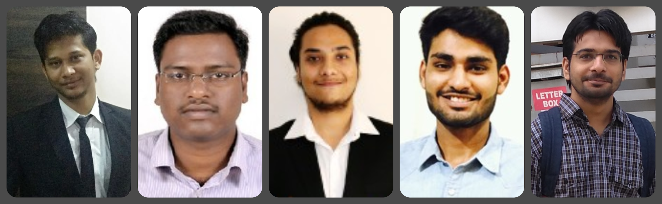
Manish Kumar
Kedar kumar
Golla
Varishu Pant
Ankit Sekseria
Rahul
Aggarwal
Thanks to my teammates for making it a fun learning experience!

Slide 34



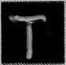








Slide 35









